Slide 1
The Battle of the Ants
Author: Henry David Thoreau
Source: Walden

Slide 2
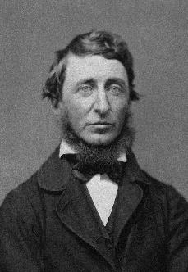
Author Background
Henry David Thoreau (1817-1862) was an American author, poet, philosopher, and naturalist. He was a key figure in the transcendentalist movement.
Henry David Thoreau
Author, Poet, Philosopher, Naturalist

Slide 3
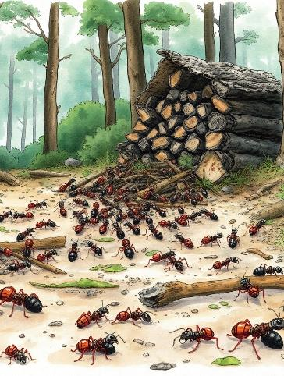
Overview of the Essay
Theme: The futility of war.
Setting: Thoreau’s woodpile, where he observes a fierce battle between ants.

Slide 4
The Ant Species
Black Ants
Black Ants: Larger, symbolize Imperialists.
Red Ants
Red Ants: Smaller, symbolize Republicans.

Slide 5
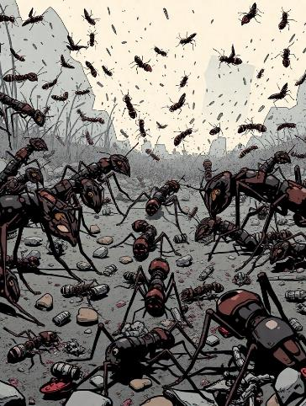
The Battle Scene
Thoreau describes the chaotic scene with ants engaged in combat.
The ground is littered with dead and dying ants.

Slide 6
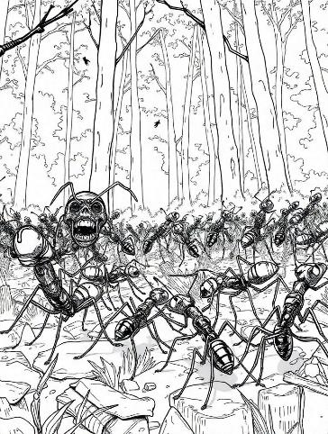
Key Observations
The ants fight without noise, contrasting with human warfare.
Thoreau notes their determination to fight to the death.

Slide 7
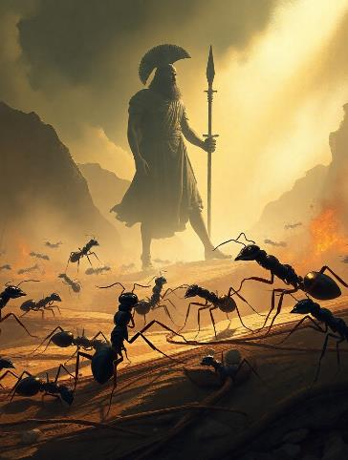
Symbolism and Allegory
Ants as Symbols: Represent human conflicts and ideologies.
Comparison to Greek mythology with references to Achilles and Patroclus.

Slide 8

Philosophical Insights
Thoreau reflects on the nature of conflict and its consequences.
He questions the purpose of human wars compared to the ants' struggle.

Slide 9
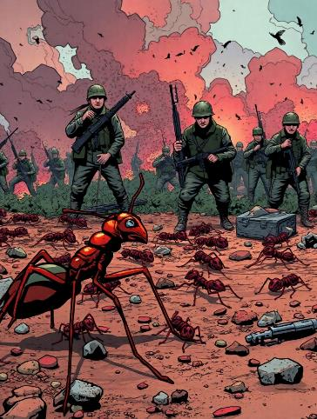
Conclusion of the Essay
Thoreau concludes that human wars are as pointless as those fought by ants.
Emphasizes the emotional impact of witnessing such violence.

Slide 10
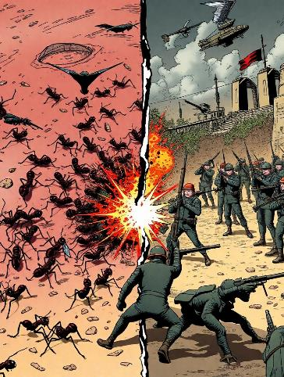
Discussion Questions
What parallels can be drawn between ant battles and human conflicts?
How does Thoreau’s observation challenge our understanding of war?

