Slide 1
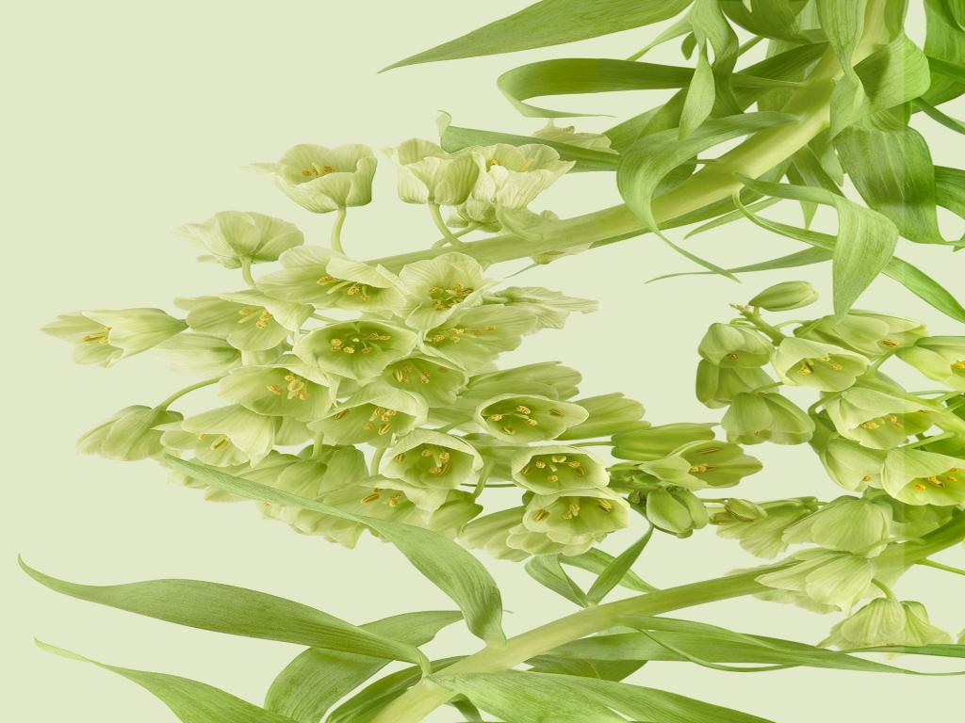
A Midsummer Night’s Dream
William Shakespeare
Presentation by,
G.Sowdambika
Guest Lecturer
English Department(SF)
C.P.A.College,Bodinayakanur

Slide 2
What was Midsummer Night’s eve?
Midsummer's Eve has been celebrated since ancient times.
It occurs on the summer solstice – around June 24.
Plants that bloom at this time were believed to have miraculous healing powers.
Bonfires were lit to protect against evil spirits.

Slide 3
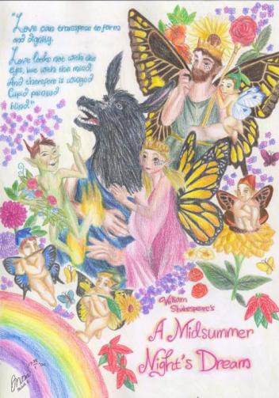
A Midsummer Night’s Dream was written by William Shakespeare in approximately 1595.
A Midsummer Night's Dream is a romantic comedy which portrays the adventures of four young Athenian lovers and a group of amateur actors in a moonlit forest, and their interactions with the fairies who inhabit it.
Comedy - in simple terms means that the play will end happily
Romantic comedy is usually based on a mix-up in events or identities. Shakespeare’s comedies often move towards tragedies (a death or lack of of resolution) but are resolved in the nick of time.
  ☺ Comedy – despair to happiness
  ☹ Tragedy – happiness to despair
  Shakespeare’s comedies often end with a wedding.

Slide 4
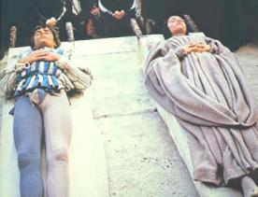
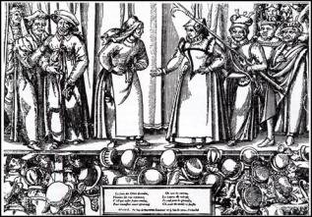
Background Notes:
A Midsummer Night's Dream is unusual among Shakespeare's plays in lacking a specific written source for its plot.
Shakespeare, however may have used other sources for inspiration.
The wedding of Theseus and Hippolyta was described in Chaucer's "Knight's Tale" and elsewhere.
The theme of a daughter who wants to marry against her father's desires was a common theme in Roman comedy and shares similarities with Shakespeare’s tragic play Romeo and Juliet.
Bottom and his friends are caricatures of the amateur players of the time and they satirize many of the theatrical conventions of the time; for example, using young men to play the roles of women.

Slide 5
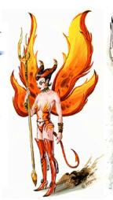
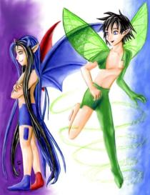
History indicates the prior to Elizabethan times, fairies were considered evil spirits who stole children and sacrificed them to the devil. Shakespeare, along with other writers, redefined fairies during this time period, turning them into gentle, albeit mischievous, spirits.
Puck, for example, brags about his ability to perform harmless pranks.
The title draws on the summer solstice, Midsummer Eve, occurring June 23 and marked by holiday partying and tales of fairies and temporary insanity.

Slide 6
The main plot
Theseus (the Duke of Athens) is getting married to Hippolyta.
Theseus hears Egeus’ complaint that his daughter, Hermia refuses to marry the man he has chosen for her. Theseus tells Egeus that she must marry Demetrius or choose between death and becoming a nun.
A group of workmen is planning to perform a play in honor of Theseus and Hippolyta’s wedding.

Slide 7

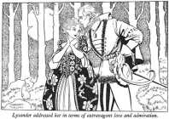
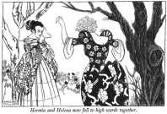
THE THREE WORLDS of
1. THE ATHENIANS:
• Theseus and his bride, Hippolyta
(Theseus represents law and order.)
• The four lovers: Hermia, Helena, Demetrius,
Lysander
(They represent adolescent rebellion.)
• Egeus (Hermia’s father)

Slide 8
There are three basic sub-plots
Sub-plot A: The Lovers
  Hermia loves Lysander, but is being forced to marry Demetrius.
  Demetrius loves Hermia, but she does not love him.
  Helena loves Demetrius, but he no longer loves her.
  Helena tells Demetrius that Hermia and Lysander plan to meet in the forest and run away together, hoping this will make him favor her.
  Demetrius heads into the forest to find them.
  Helena follows Demetrius into the forest.

Slide 9
Sub-plot C: The actors
The workmen go into the forest to rehearse the play they are performing for Theseus and Hippolyta’s wedding.
At this point all three groups are in the woods: the lovers, the fairies, and the actors.
A series of mix-ups occur, when Puck places the love potion from the magic flower in Lysander’s eyes instead of Demetrius’s.

Slide 10
Sub-plot B: The Fairies
Meanwhile, in the forest… Oberon (King of the Fairies) is arguing with Titania (the Fairy Queen), because he wants to adopt the orphan child she has raised from infancy.
He devises a plan to use a magic flower to trick Titania into giving him the child. When the nectar from the flower is placed in someone’s eyes while sleeping, they fall in love with the first person they see upon waking.
He sends his servant, Puck, to find the magic flower and use it on Titania.
While Puck is obtaining the flower, Oberon overhears Helena and Demetrius arguing and decides to help them resolve their dispute with the powers of the magic flower. He instructs Puck to find Demetrius and place some flower nectar in his eyes too.

Slide 11
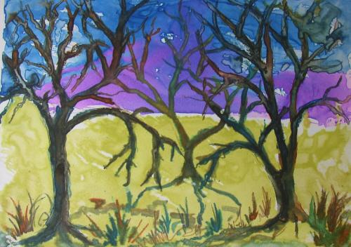
The three worlds come together in the woods at night: a place of magic and mystery where illusion reigns!
Shakespeare cleverly weaves together not only fairies and lovers, but also social hierarchies with the aristocratic Theseus and the "rude mechanicals," or the artisans and working men. This allows the play to become more lyrical, since it is able to draw on the rougher language of the lower classes as well as the poetry of the noblemen.

Slide 12
The setting
In the forest outside of Athens, Greece…

Slide 13
TOPICS in the play
In act One, Lysander laments: “The course of true love never did run smooth” (1.1.134).
The play deals with the trials of those “in love” both in the world of the Athenians and the world of the fairies.
Because the play is a romantic comedy, the audience can enjoy the conflicts, mix ups, and misunderstandings without ever doubting that all will turn out well.
Other topics (besides “love”):
Reality versus illusion
Friendship
Parental authority
Dreams

Slide 14
The main themes of the play
What is love?
How and why do people fall in and out of love?
Are lovers in control of their destinies?
What is more real, the “daylight” world of reason and law or the “nighttime” world of passion and chaos?
  From Study Guide for A Midsummer Night’s Dream, Glencoe-McGraw-Hill

Slide 15
The play is a study in
CONTRASTS
The contrasts add balance to the play.
Some of the contrasts in the play:
Reality vs. Illusion (Dreams)
Athens vs. the forest
Day vs. Night
Order vs. Confusion
Aristocrats vs. Workmen
Tall vs. Short
True love vs. False love
Lyrical language vs. Rough prose

Slide 16
TERMS TO KNOW
Shakespeare writes in both VERSE and PROSE
VERSE – elevated passages, significant ideas, speeches by high
ranking individuals
PROSE – comic scenes, dialect or broken English (slang/not
proper) and speeches by commoners are in prose (written or
spoken word)
POETRY is usually blank verse – iambic pentameter lines without
rhyme
IAMBIC PENTAMETRE – five beats (feet) per line with a light/ heavy
stress pattern (ten syllables).
RHYME is used (couplet or sonnet) to illustrate the close of scenes
or important passages (soliloquy – the act of speaking when alone
or regardless of any listeners, often a character’s inner thoughts)

Slide 17
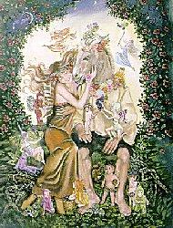
The End

